Slide 1
Memory Virtualization & Paging

Slide 2
Learning Outcomes
LO 2 : (C3) Application: Construct Infrastructure as Code (IaC) templates and Docker configurations to automate the deployment of cloud-native environments.LO 3 : Analyze system requirements to identify actors, processes, data, and interactions
LO 4 : Apply UML-based design artifacts to communicate a complete system solution

Slide 3
Outline
Shadow Page Tables
Address Translation
Overcommitment and Memory Ballooning
Hardware Support for Memory Virtualization: EPT / NPT
Notes:
In this session, we will discuss how memory is virtualized in a virtual machine environment. We begin with shadow page tables, which help the hypervisor manage memory mappings between guest systems and the host machine. After that, we discuss address translation to understand how virtual memory addresses are converted into real physical memory locations.
We will also cover overcommitment and memory ballooning, which are techniques used by hypervisors to manage limited physical memory across multiple virtual machines. Finally, we will discuss hardware support for memory virtualization, especially EPT and NPT, which improve the efficiency of memory address translation in modern processors.

Slide 4
Shadow Page Tables

Slide 5
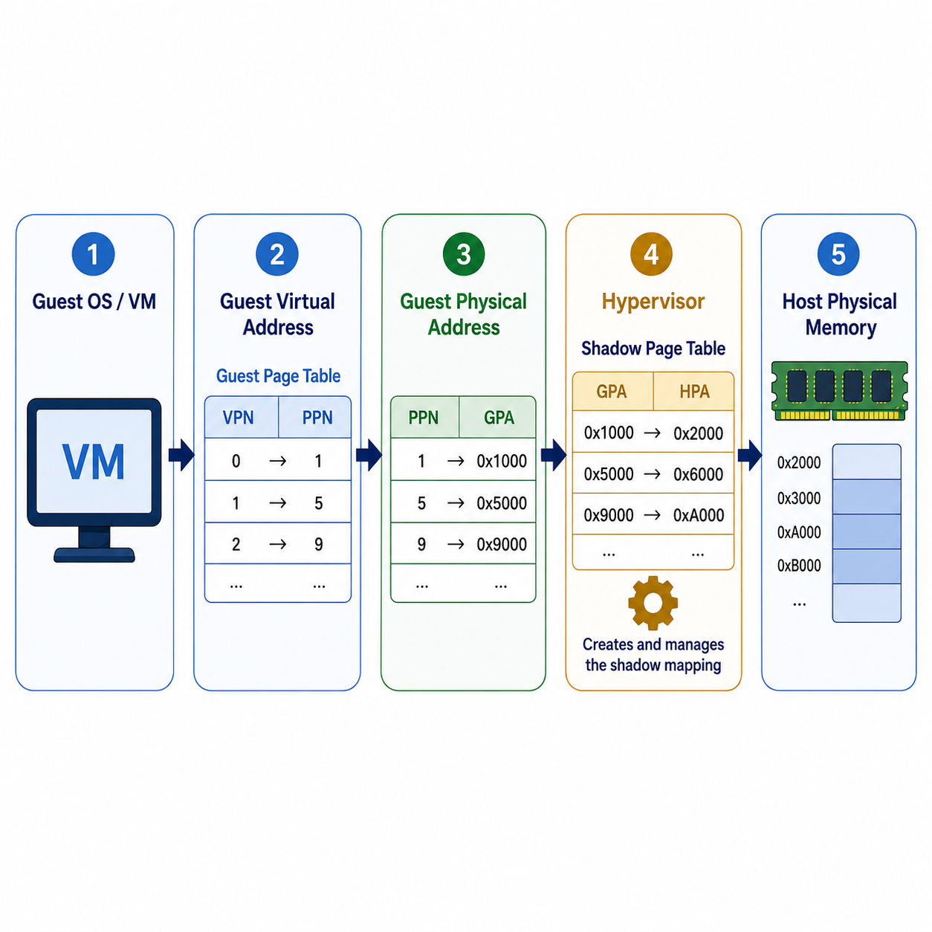
Shadow Page Tables
What Are Shadow Page Tables?
A shadow page table is managed by the hypervisor
It maps guest memory access to real host memory
The guest OS still maintains its own page table
The hypervisor creates a “shadow” mapping for safe execution
This allows the VM to run while the hypervisor controls real memory
Notes:
A shadow page table is a memory mapping structure maintained by the hypervisor. In a virtual machine, the guest operating system believes that it manages its own physical memory. However, the real physical memory belongs to the host machine and must be controlled by the hypervisor.
Because of this, the hypervisor creates a shadow version of the guest page table. This shadow page table maps the guest’s virtual memory access to the actual host physical memory. From the guest OS perspective, it still works as if it controls memory normally. But in reality, the hypervisor uses the shadow page table to maintain isolation, safety, and control over memory access.

Slide 6
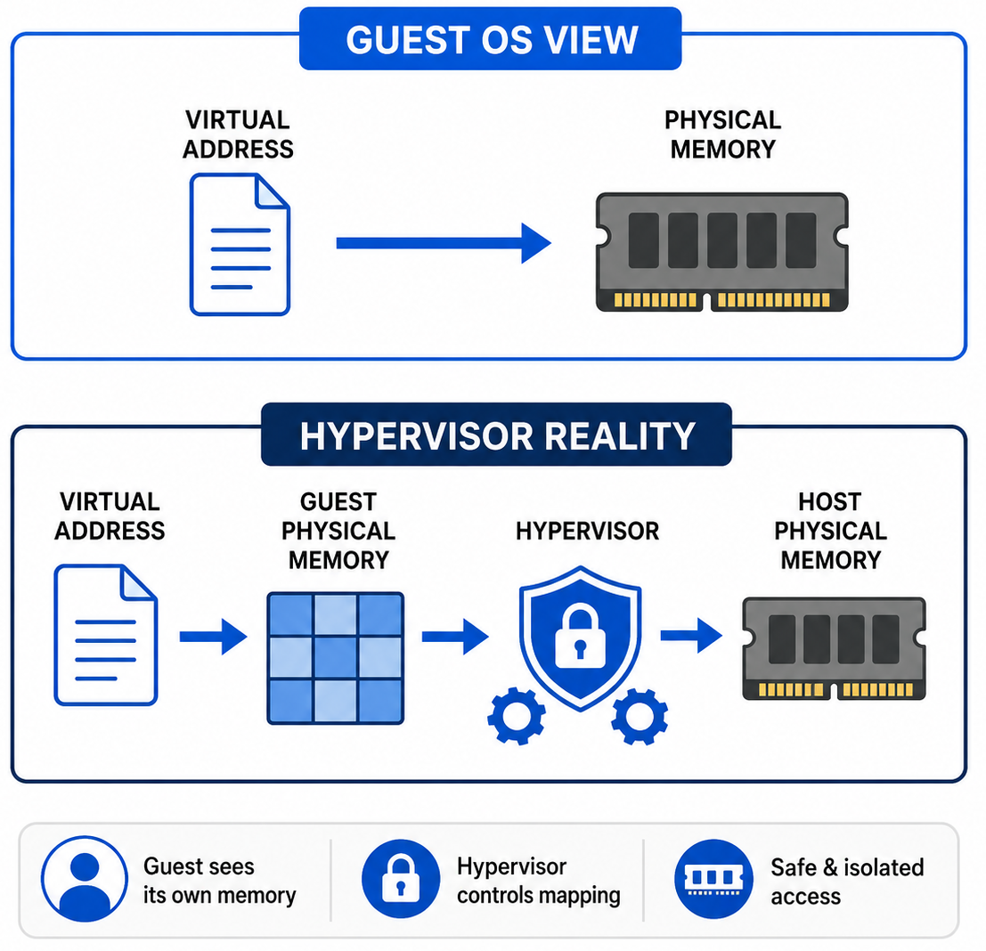
Shadow Page Tables
What Are Shadow Page Tables?
Guest OS thinks it controls physical memory
Host physical memory is actually controlled by the hypervisor
Direct memory access could break isolation between VMs
Address translation becomes more complex in virtual machines
Shadow page tables help the hypervisor maintain safe memory mapping
Notes:
Shadow page tables are needed because the guest operating system believes that it is managing its own physical memory. In a normal machine, the operating system maps virtual addresses to physical memory directly. However, in a virtual machine environment, the guest OS does not actually control the real physical memory of the host machine.
The real physical memory is managed by the hypervisor. This creates a problem because the guest OS still needs to perform memory translation, but the hypervisor must ensure that each virtual machine can only access the memory assigned to it. Without this control, one VM could potentially interfere with another VM or with the host system.
Shadow page tables solve this problem by allowing the hypervisor to maintain a controlled mapping between the guest’s memory view and the actual host physical memory. This makes memory access safer while still allowing the guest OS to run as if it had its own memory.

Slide 7
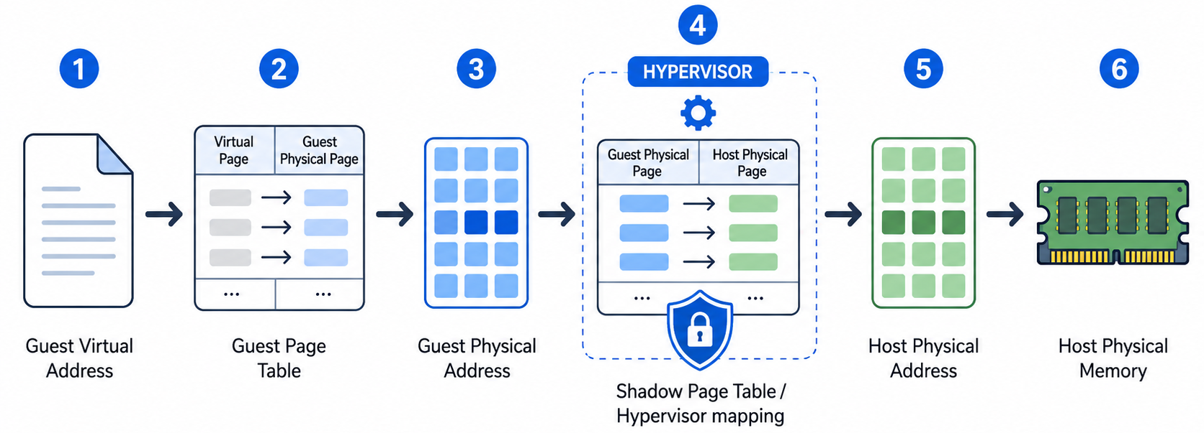
Shadow Page Tables
How Shadow Page Tables Work?
Notes:
Shadow page tables work by combining two levels of memory mapping. First, the guest operating system translates a guest virtual address using its own page table. From the guest OS perspective, this produces a physical memory address. However, this address is not the real physical memory of the machine. It is only the guest physical address assigned to the virtual machine.
The hypervisor then maps that guest physical address to the actual host physical memory. To make this process safe and efficient, the hypervisor maintains a shadow page table. This shadow page table combines the guest-level mapping and the host-level mapping, so memory access can be directed to the correct location in the host machine while still preserving VM isolation.
In simple terms, the guest OS sees its own memory, but the hypervisor controls where that memory actually exists on the host.

Slide 8
Address Translation

Slide 9
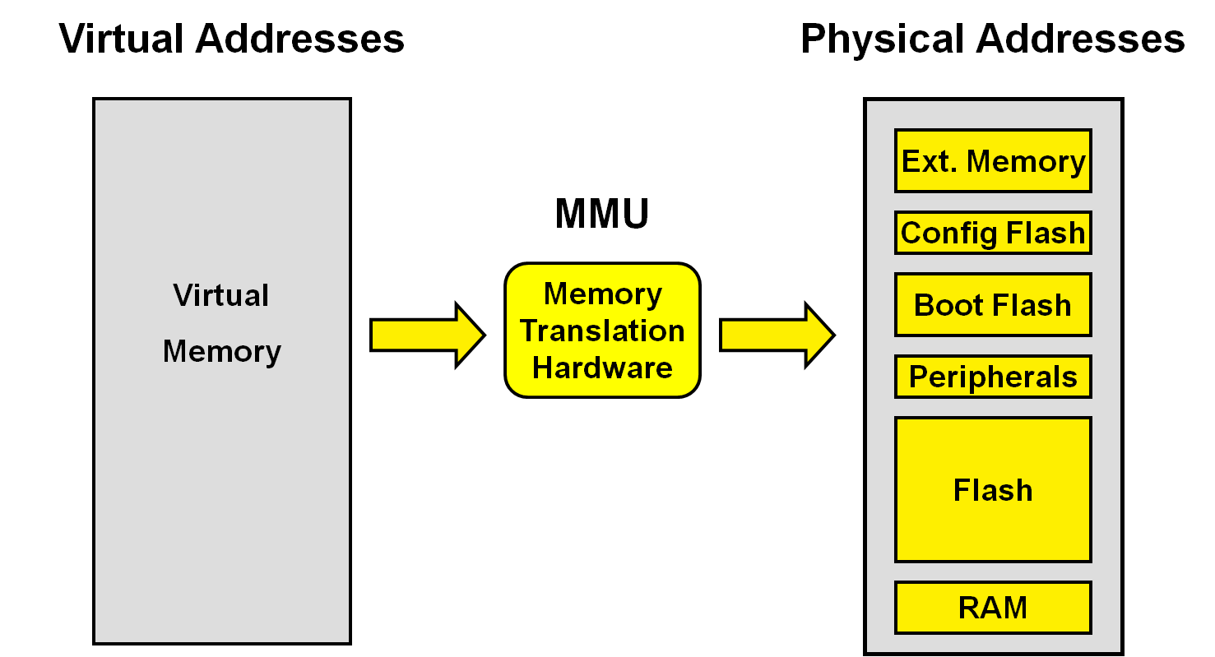
Address Translation
Address Translation Definition
Address translation converts virtual addresses into physical addresses
Applications do not directly access physical memory
The operating system uses page tables to manage address mapping
This allows each process to have its own memory view
Memory access becomes controlled, organized, and protected
Image retreived from https://skills.microchip.com/pic32mz-core-architecture/699116
Notes:
Address translation is the process of converting a virtual memory address into a physical memory address. Applications usually do not directly access physical memory. Instead, they use virtual addresses, and the operating system manages the mapping between virtual memory and physical memory using page tables.
In a virtual machine environment, this process becomes more complex. The guest operating system believes it is translating virtual addresses into physical memory, but that physical memory is actually guest physical memory. The hypervisor must then map the guest physical memory to the real host physical memory. This is why address translation is important in memory virtualization.

Slide 10
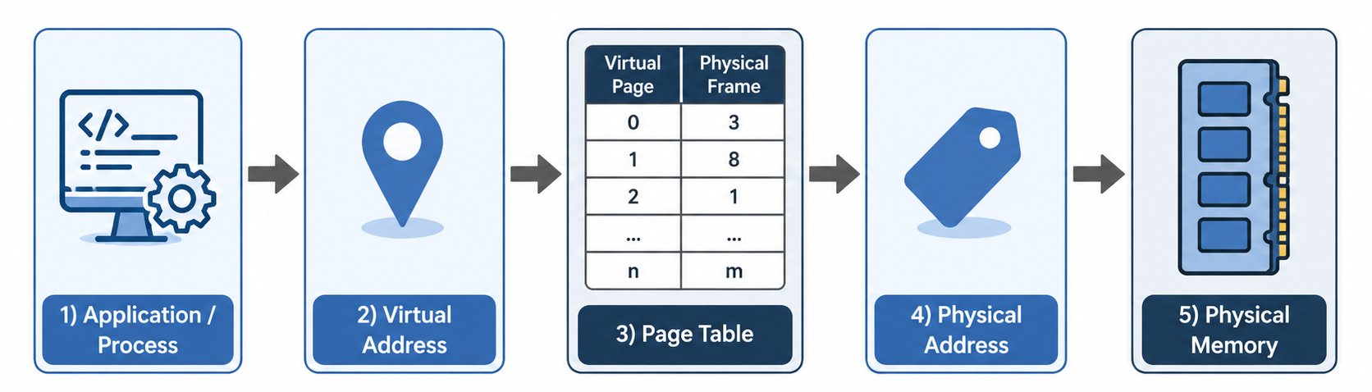
Address Translation
Address Translation Process
Notes:
Address translation is the process of converting a virtual memory address into a physical memory address. Applications usually do not directly access physical memory. Instead, they use virtual addresses, and the operating system manages the mapping between virtual memory and physical memory using page tables.
In a virtual machine environment, this process becomes more complex. The guest operating system believes it is translating virtual addresses into physical memory, but that physical memory is actually guest physical memory. The hypervisor must then map the guest physical memory to the real host physical memory. This is why address translation is important in memory virtualization.

Slide 11
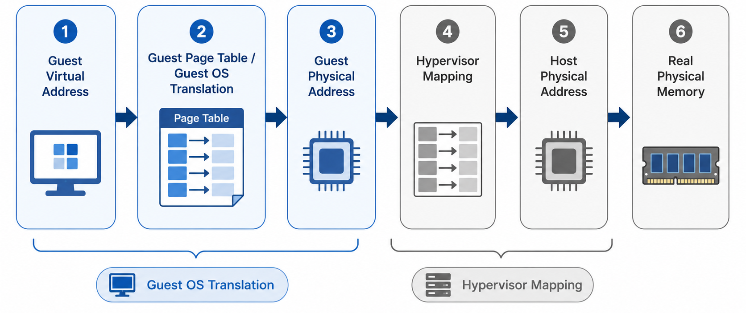
Address Translation
Address Translation in Virtual Machines
Notes:
In a virtual machine, address translation happens in more than one layer. First, the guest operating system translates a guest virtual address into a guest physical address, just as it would in a normal system. However, that guest physical address is not the real physical memory of the host machine.
The hypervisor then performs another mapping step, translating the guest physical address into a host physical address. This host physical address points to the actual memory hardware. Because of this layered translation, each virtual machine can operate as if it has its own memory space, while the hypervisor still maintains isolation and control over the real physical memory.

Slide 12
Overcommitment and Memory Ballooning

Slide 13
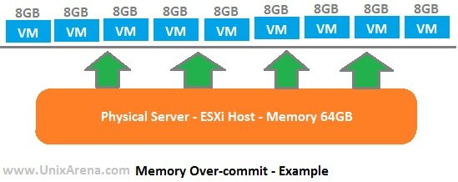
Overcommitment and Memory Ballooning
Memory Overcommitment
Hypervisor allocates more virtual memory than available physical memory
Assumes not all VMs use their full memory allocation at the same time
Improves physical memory utilization
Allows more virtual machines to run on the same host
Useful for resource sharing, but must be carefully managed
Image retreived from https://unixarena.com/2014/07/how-vmware-vsphere-is-saving-physical-memory.html/
Notes:
Memory overcommitment is a technique where the hypervisor allocates more virtual memory to virtual machines than the amount of physical memory actually available on the host. This may sound risky, but it works because most virtual machines do not use all of their assigned memory at the same time.
For example, a host may only have 64 GB of physical memory, but the hypervisor may assign a total of 96 GB or more across multiple VMs. As long as the VMs do not actively use all of that memory at once, the system can still run efficiently. This allows cloud and virtualization platforms to improve resource utilization and support more workloads on the same hardware.
However, overcommitment must be managed carefully. If too many VMs suddenly need their full memory allocation, the host can experience memory pressure, which may reduce performance.

Slide 14
Overcommitment and Memory Ballooning
The Risk of Overcommitment
Safe Overcommitment | Memory Pressure
VMs are allocated more memory than the host physically has | Many VMs actively use their allocated memory
Actual memory usage is still low | Actual memory demand exceeds host memory
Host can still manage workloads efficiently | Hypervisor must reclaim, compress, or swap memory
Performance remains stable | Performance may degrade
Resource sharing works well | Overcommitment becomes risky
Notes:
Memory overcommitment is useful when the total allocated memory is higher than the physical memory, but actual usage remains low. In this condition, the host can still run multiple virtual machines efficiently because not every VM uses its full allocation at the same time.
The risk appears when many VMs become active and start demanding more memory simultaneously. At that point, the actual memory demand can exceed the available physical memory on the host. The hypervisor must then take action, such as reclaiming memory, compressing memory pages, or swapping to disk. These techniques help keep the system running, but they can reduce performance.
This is why memory overcommitment should be monitored carefully. It improves efficiency, but if memory pressure becomes too high, it can lead to slower VM performance.

Slide 15
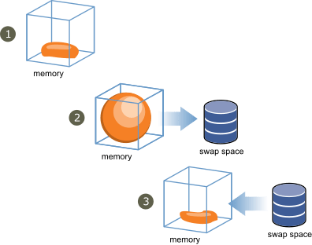
Overcommitment and Memory Ballooning
Memory Ballooning
Reclaims memory from guest VMs
Uses a balloon driver inside the guest OS
Hypervisor inflates the balloon when memory is needed
Guest available memory is reduced
Reclaimed memory can be used elsewhere
Image retreived from https://virtualmaestro.in/2020/06/06/vmware-vsphere-7-x-memory-reclamation-part-4-ballooning/
Notes:
Memory ballooning is a technique used by the hypervisor to reclaim memory from a virtual machine when the host needs more memory. To do this, a balloon driver runs inside the guest operating system. When the hypervisor detects memory pressure, it asks the balloon driver to inflate.
As the balloon inflates, it consumes memory inside the guest VM. From the guest operating system’s perspective, less memory is now available for normal applications. This allows the guest OS to release or reorganize memory pages, and the hypervisor can reclaim that memory for other virtual machines or workloads. In this way, ballooning helps the host redistribute memory dynamically without immediately relying on swapping.

Slide 16
Hardware Support for Memory Virtualization: EPT / NPT

Slide 17
Overcommitment and Memory Ballooning
Why is it needed?
Software-Managed Memory Virtualization | Hardware-Assisted Memory Virtualization
Hypervisor manages shadow page tables | CPU assists memory translation
Frequent synchronization is needed | Translation is handled more efficiently
More overhead | Lower overhead
Harder to scale with many VMs | More scalable for modern VMs
Notes:
Shadow page tables allow the hypervisor to control memory mapping between guest virtual machines and the real host memory. However, this approach can create overhead because the hypervisor must maintain shadow mappings and keep them consistent with the guest operating system’s page tables.
When the guest OS changes its page table, the hypervisor may need to update the shadow page table as well. This adds extra work during memory translation and memory management. As the number of virtual machines increases, this overhead can become more significant.
This is why modern processors include hardware support for memory virtualization. Instead of relying only on software-managed shadow page tables, the CPU can help perform the second level of address translation. This makes memory virtualization faster, more efficient, and more scalable for modern virtualization platforms.

Slide 18
Overcommitment and Memory Ballooning
EPT/NPT
EPT stands for Extended Page Tables by Intel
NPT stands for Nested Page Tables by AMD
Has role as second-level address translation
Maps guest physical address to host physical address
Reduces hypervisor overhead
Notes:
Shadow page tables allow the hypervisor to control memory mapping between guest virtual machines and the real host memory. However, this approach can create overhead because the hypervisor must maintain shadow mappings and keep them consistent with the guest operating system’s page tables.
When the guest OS changes its page table, the hypervisor may need to update the shadow page table as well. This adds extra work during memory translation and memory management. As the number of virtual machines increases, this overhead can become more significant.
This is why modern processors include hardware support for memory virtualization. Instead of relying only on software-managed shadow page tables, the CPU can help perform the second level of address translation. This makes memory virtualization faster, more efficient, and more scalable for modern virtualization platforms.

Slide 19
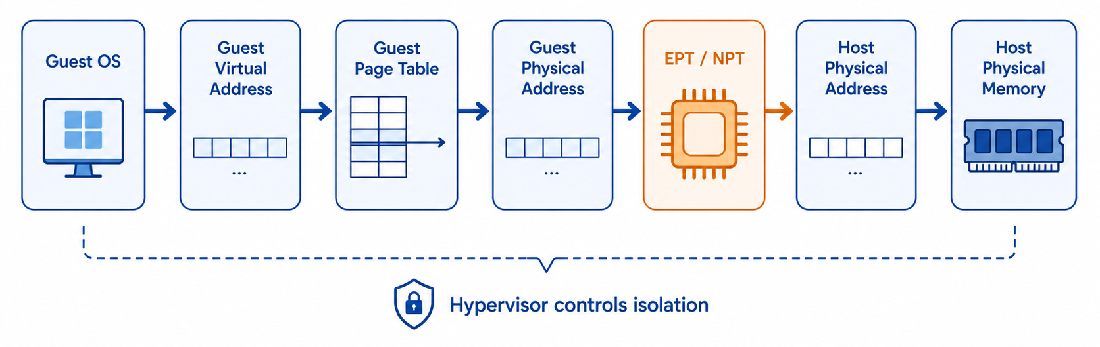
Address Translation
EPT / NPT Translation Flow
Notes:
In a virtual machine, address translation happens in more than one layer. First, the guest operating system translates a guest virtual address into a guest physical address, just as it would in a normal system. However, that guest physical address is not the real physical memory of the host machine.
The hypervisor then performs another mapping step, translating the guest physical address into a host physical address. This host physical address points to the actual memory hardware. Because of this layered translation, each virtual machine can operate as if it has its own memory space, while the hypervisor still maintains isolation and control over the real physical memory.

Slide 20
Assignment
Find study case on overcommitment and memory ballooning!
Explain the case and effects of it

Slide 21
References
EPT/NPT
Erl, T., & Barceló Monroy, E. (2024). Cloud computing: Concepts, technology, security, and architecture (2nd ed.). Pearson.
Katzer, J. (2021). Learning serverless: Design, develop, and deploy with confidence (1st ed.). O’Reilly Media.
Marinescu, D. C. (2023). Cloud computing: Theory and practice (3rd ed.). Morgan Kaufmann.
Notes:
Shadow page tables allow the hypervisor to control memory mapping between guest virtual machines and the real host memory. However, this approach can create overhead because the hypervisor must maintain shadow mappings and keep them consistent with the guest operating system’s page tables.
When the guest OS changes its page table, the hypervisor may need to update the shadow page table as well. This adds extra work during memory translation and memory management. As the number of virtual machines increases, this overhead can become more significant.
This is why modern processors include hardware support for memory virtualization. Instead of relying only on software-managed shadow page tables, the CPU can help perform the second level of address translation. This makes memory virtualization faster, more efficient, and more scalable for modern virtualization platforms.

